Slide 1
Lecture 4

Slide 2
Distribution functions. & Variable Transformation

Slide 3






Dist. Functionss & Transformation of R.V’s

Slide 4





Method of distribution functions

Slide 5


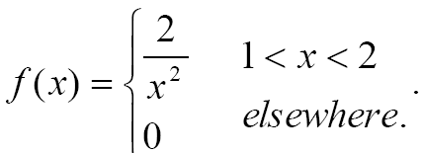
Method of distribution functions

Slide 6




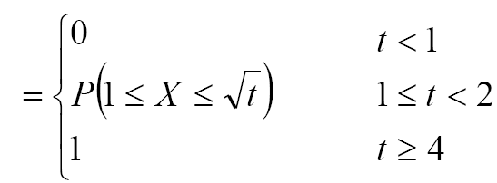
Method of distribution functions

Slide 7

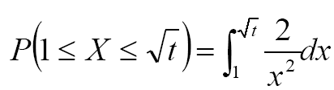
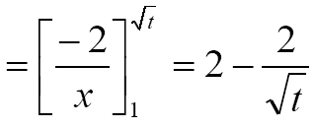

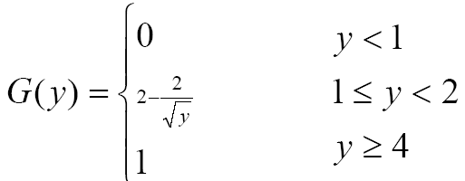
Method of distribution functions

Slide 8

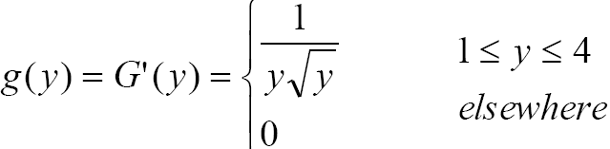
Method of distribution functions

Slide 9

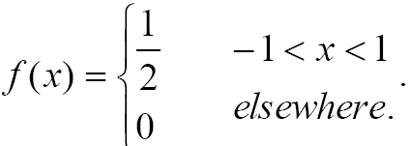

Method of distribution functions

Slide 10


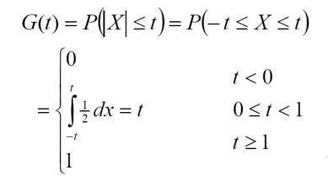
Method of distribution functions

Slide 11

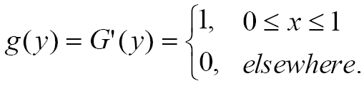
Method of distribution functions

Slide 12



Method of distribution functions

Slide 13






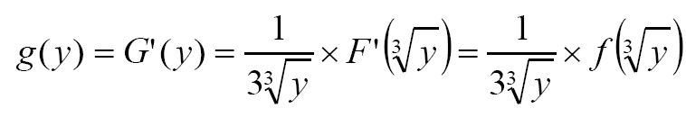

Method of distribution functions

Slide 14

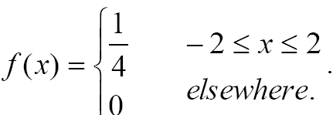


Method of distribution functions

Slide 15





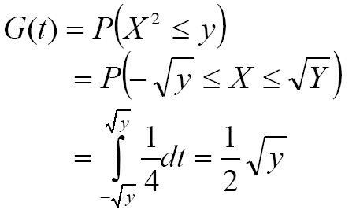
Method of distribution functions

Slide 16
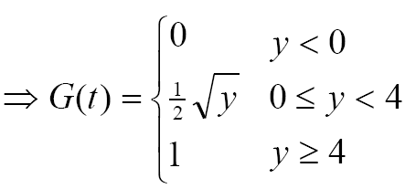

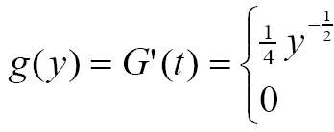
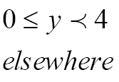
Method of distribution functions

Slide 17




Method of Transformation

Slide 18

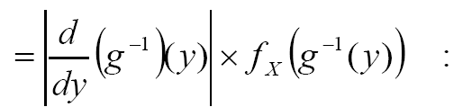

Method of Transformation

Slide 19


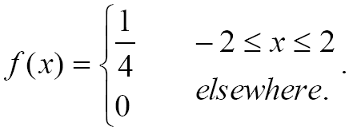

Method of Transformation

Slide 20



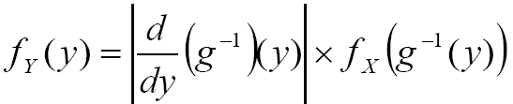

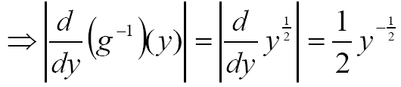
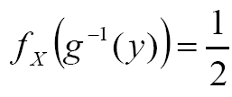

Method of Transformation

Slide 21

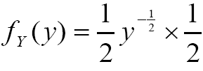
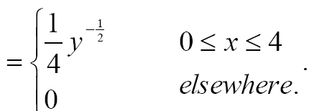
Method of Transformation

Slide 22


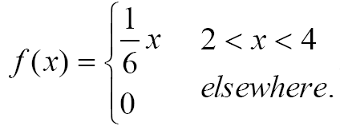


Method of Transformation

Slide 23


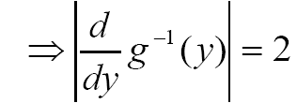


Method of Transformation

Slide 24

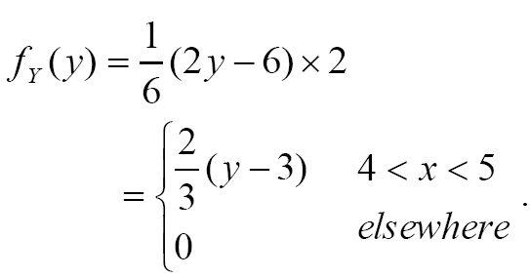
Method of Transformation

Slide 25

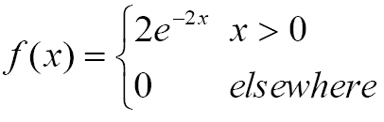

Method of Transformation

Slide 26



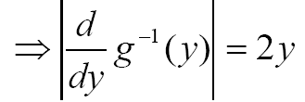




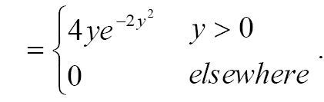
Method of Transformation

Slide 27





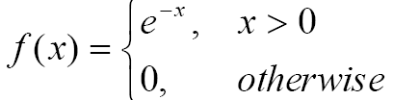


Method of Transformation

Slide 28
GENERATING FUNCTIONS
Moments Generating Functions
Factorial Generating Functions

Slide 29





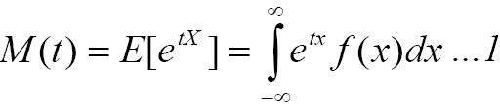
MOMENT GENERATING FUNCTION

Slide 30

MOMENT GENERATING FUNCTION

Slide 31





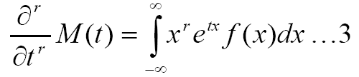

MOMENT GENERATING FUNCTION

Slide 32


MOMENT GENERATING FUNCTION

Slide 33
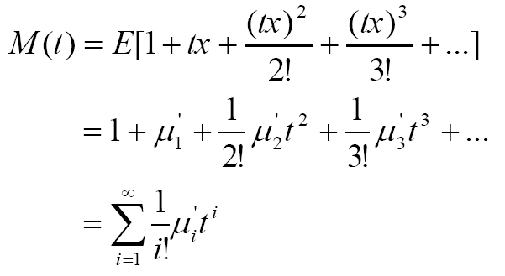



MOMENT GENERATING FUNCTION

Slide 34


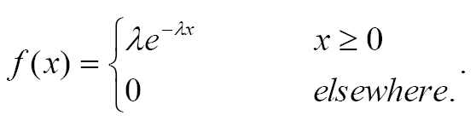

MOMENT GENERATING FUNCTION

Slide 35

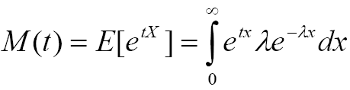
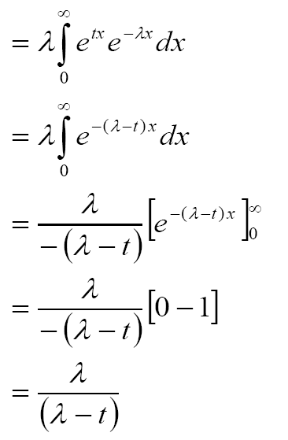
MOMENT GENERATING FUNCTION

Slide 36

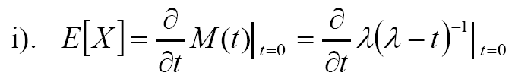
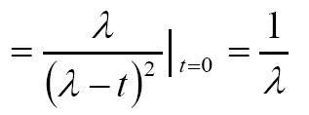
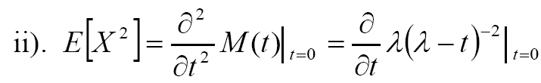
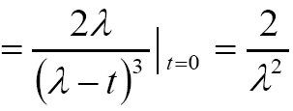
MOMENT GENERATING FUNCTION

Slide 37

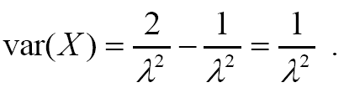
MOMENT GENERATING FUNCTION

Slide 38


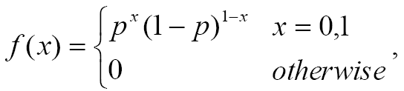

MOMENT GENERATING FUNCTION

Slide 39
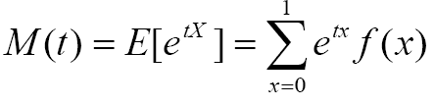
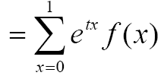
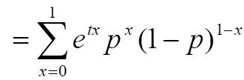



MOMENT GENERATING FUNCTION

Slide 40
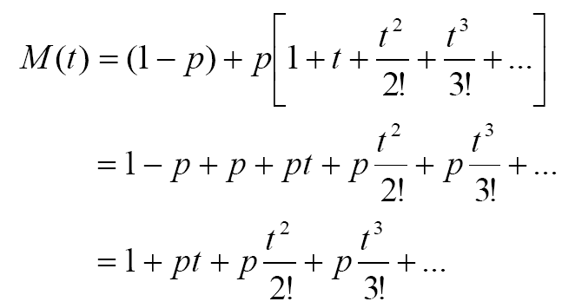
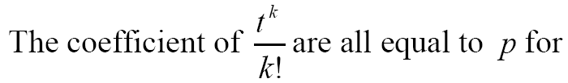

MOMENT GENERATING FUNCTION

Slide 41






MOMENT GENERATING FUNCTION

Slide 42

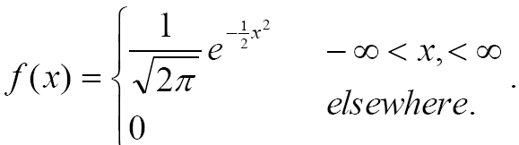

MOMENT GENERATING FUNCTION

Slide 43

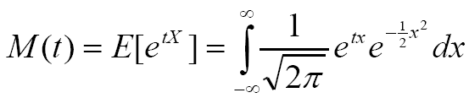
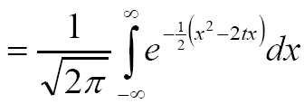
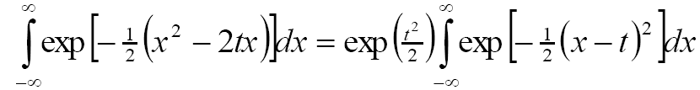
MOMENT GENERATING FUNCTION

Slide 44




MOMENT GENERATING FUNCTION

Slide 45





MOMENT GENERATING FUNCTION

Slide 46




MOMENT GENERATING FUNCTION

Slide 47



MOMENT GENERATING FUNCTION

Slide 48

MOMENT GENERATING FUNCTION

Slide 49




FACTORIAL GENERATING FUNCTIONS

Slide 50


FACTORIAL GENERATING FUNCTIONS

Slide 51




FACTORIAL GENERATING FUNCTIONS

Slide 52


FACTORIAL GENERATING FUNCTIONS

Slide 53




FACTORIAL GENERATING FUNCTIONS

Slide 54


FACTORIAL GENERATING FUNCTIONS

Slide 55






FACTORIAL GENERATING FUNCTIONS

Slide 56






FACTORIAL GENERATING FUNCTIONS

Slide 57

FACTORIAL GENERATING FUNCTIONS

Slide 58



FACTORIAL GENERATING FUNCTIONS

Slide 59
12:03:53 PM
Time check

